Slide 1
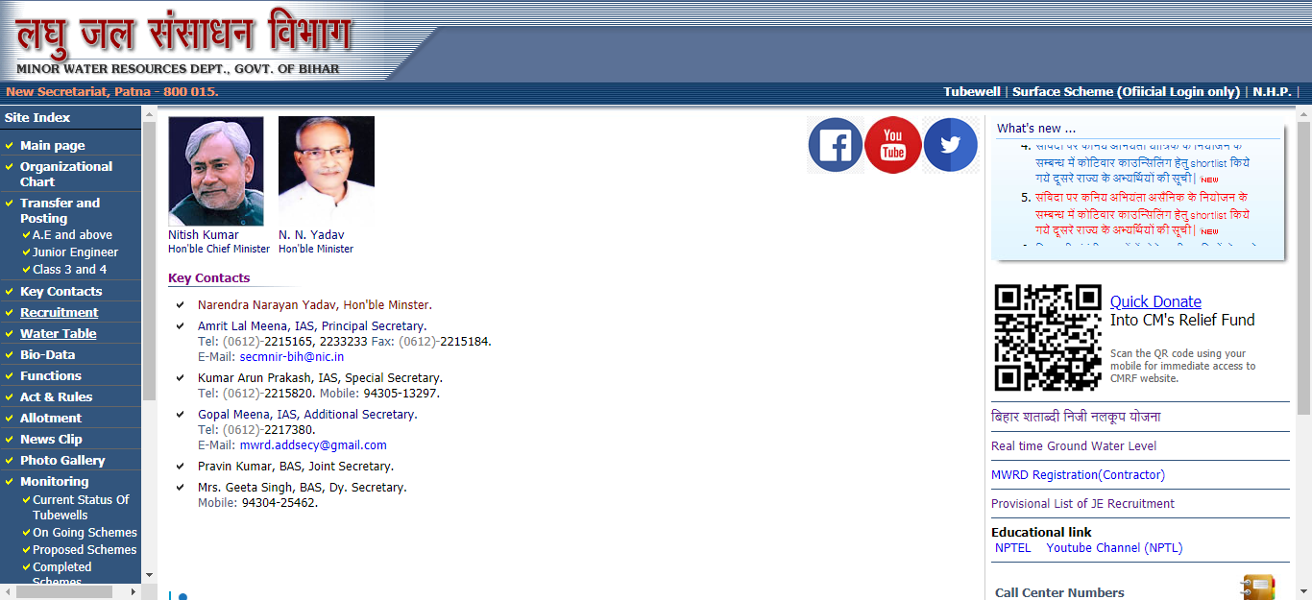
Tube well Software User guide
Click on Tube well link
on our website

Slide 2
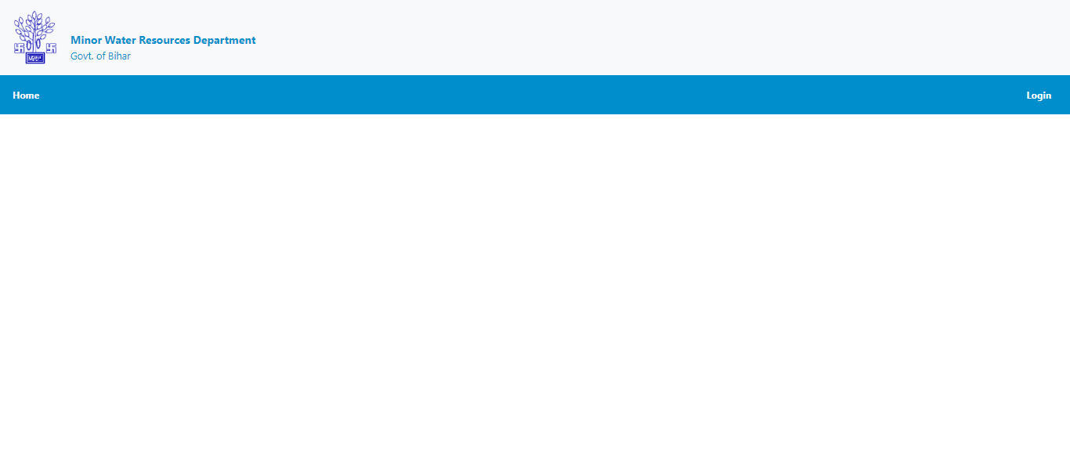
Tube well Software User guide
Click on Login link for
login page

Slide 3
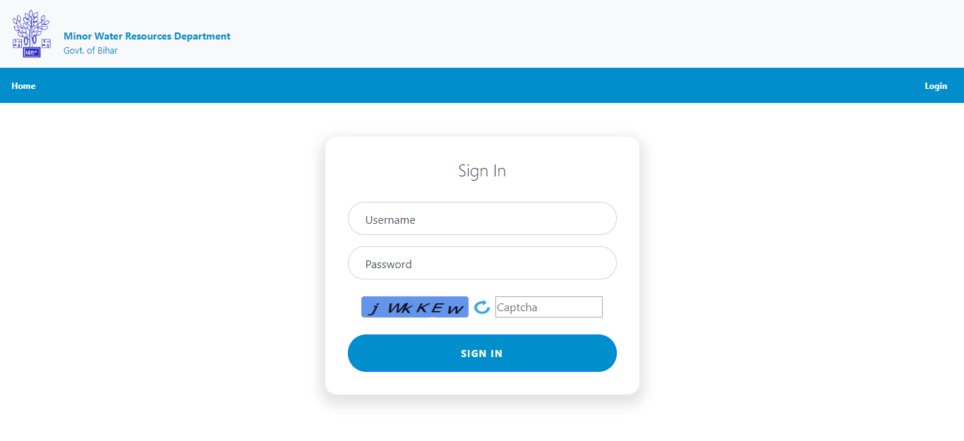
Tube well Software User guide
For EE Username & password
will be the same as in Bihar
Shatabdi Niji Nalkup Yojna
Application until you change it.
Enter Username, password,
Captcha and click on SIGN IN
Button to login.

Slide 4
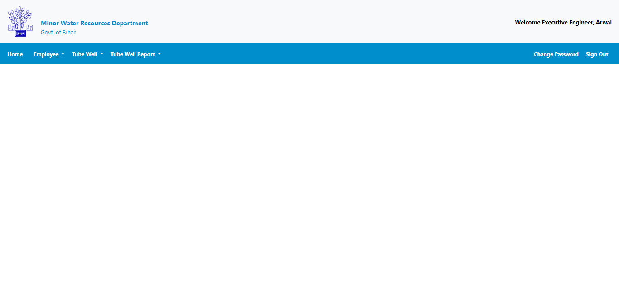
Tube well Software User guide
After successful login, you will see Welcome message on top right corner.
Here in this case its Executive Engineer Login.

Slide 5
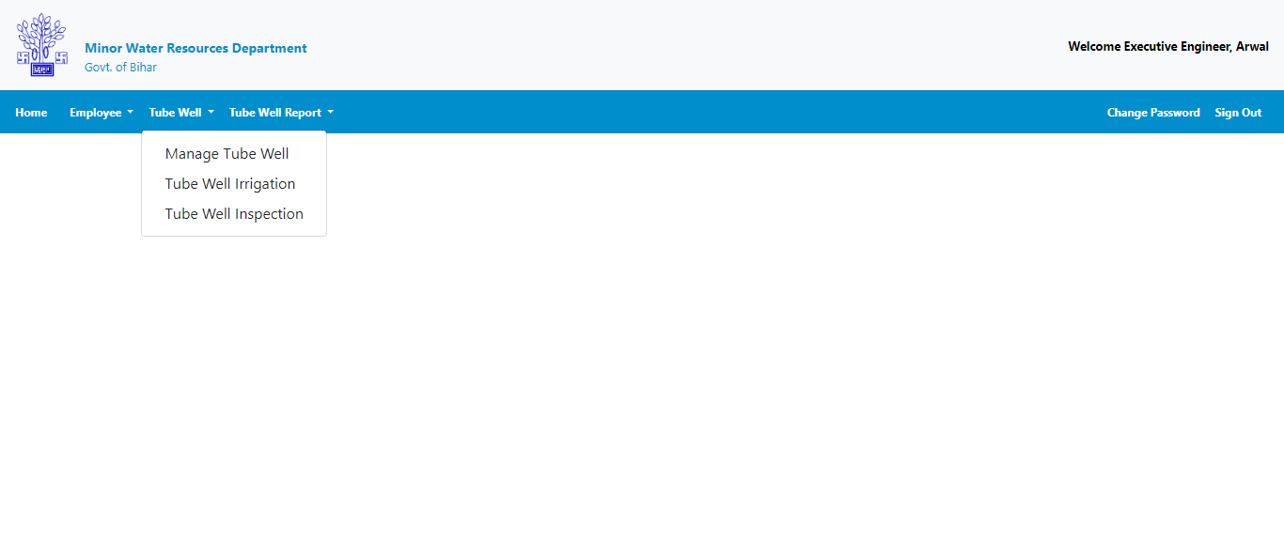
Tube well Software User guide
Click on tube well menu
to expand Tube Well menu
Click on Manage tube well
to add and edit tube well

Slide 6
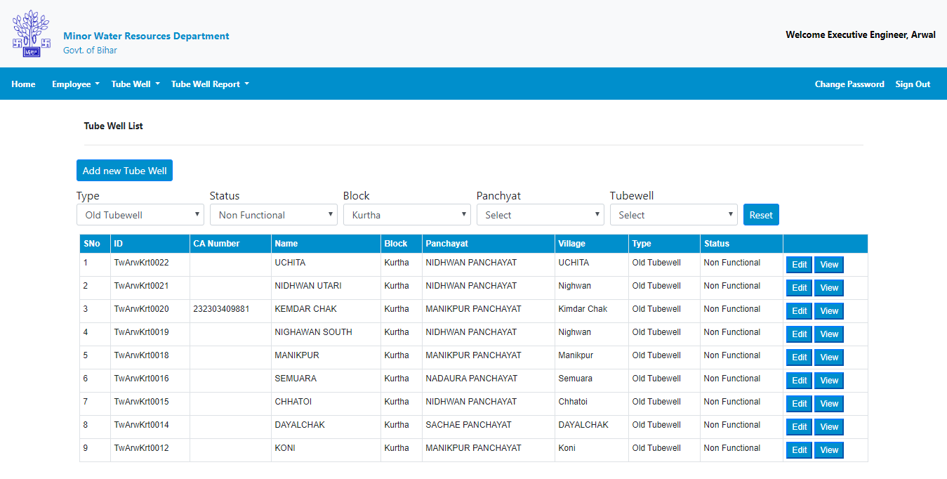
Tube well Software User guide
Click here to add new
Tube well

Slide 7
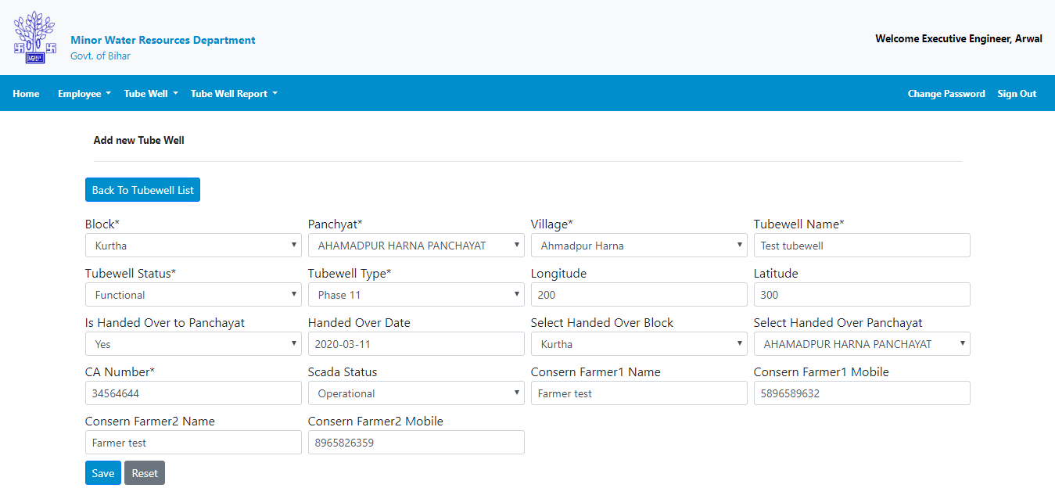
Tube well Software User guide
Upon saved successfully message
click here to back on tube well list.
Enter required detail and click on
Save button to add.

Slide 8
Tube well Software User guide
Upon saved successfully message
click here to back on tube well list.
Enter required detail and click on
Save button to add.

Slide 9
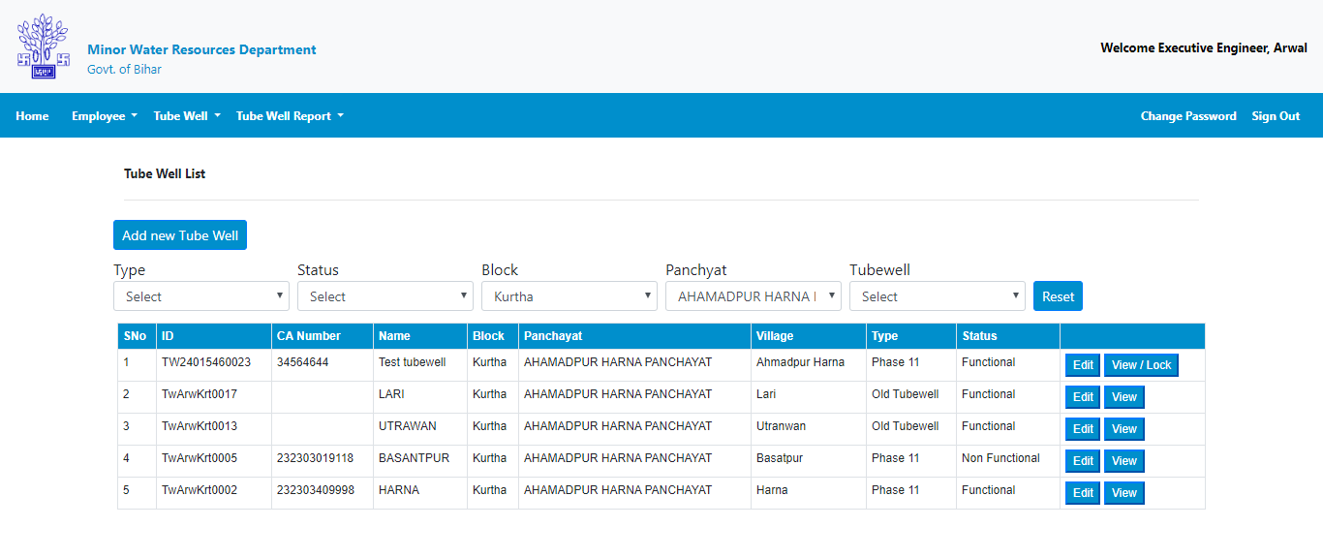
Tube well Software User guide
You will see newly entered tube well in the list.
Use block, Panchayat & other criteria to find your tube well in list
To update any detail click on edit button.

Slide 10
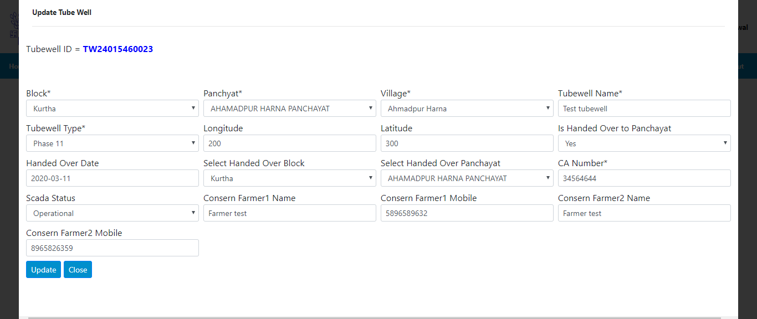
Tube well Software User guide
If required change your data & Click on update button to update.

Slide 11
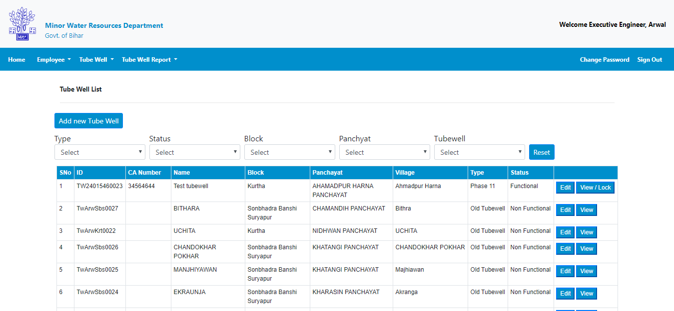
Tube well Software User guide
Click on View/Lock button to view and lock tube well data.

Slide 12
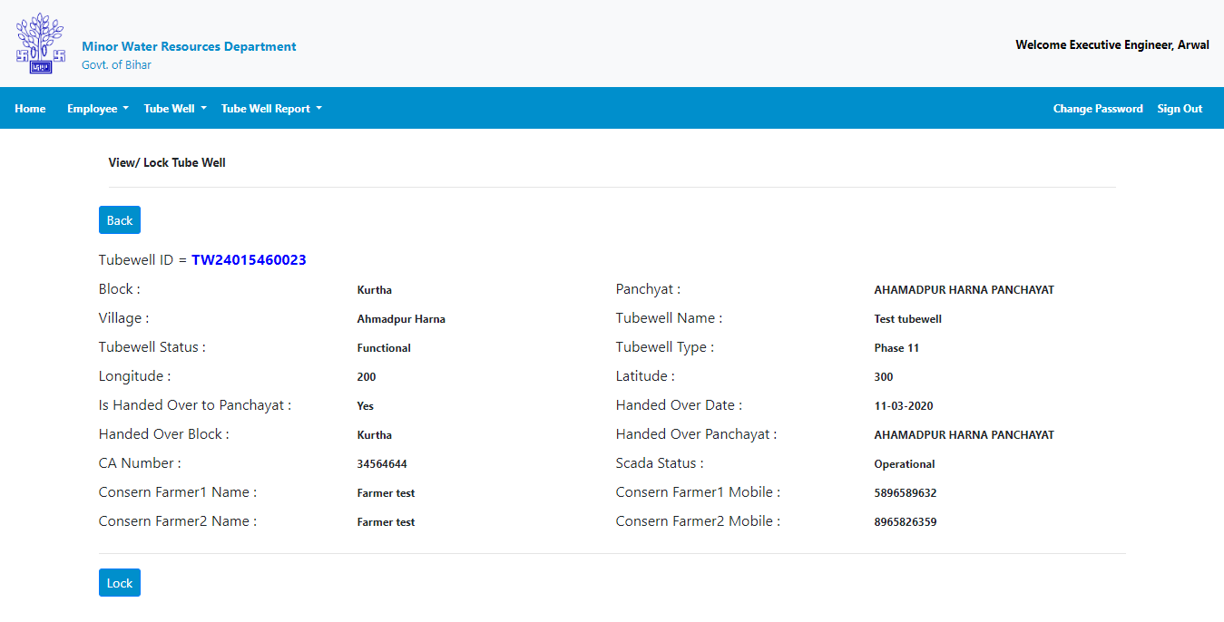
Tube well Software User guide
Locking Tube well data will disable edit of Block, Panchayat, Village and Tube well name
and it will be automatically forwarded to nodal for confirmation. After confirmation of nodal tube well will be added.
Click on Lock button to lock tube well data.

Slide 13
Tube well Software User guide
Click on Tube well irrigation to navigate to tube well irrigation page.

Slide 14
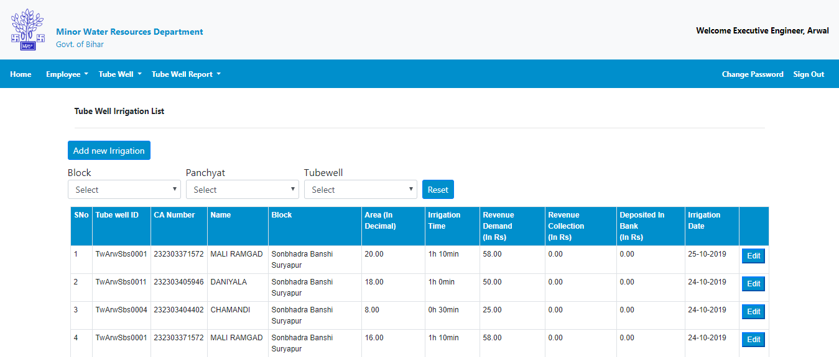
Tube well Software User guide
Click on Add new irrigation to add new Tube well irrigation.

Slide 15
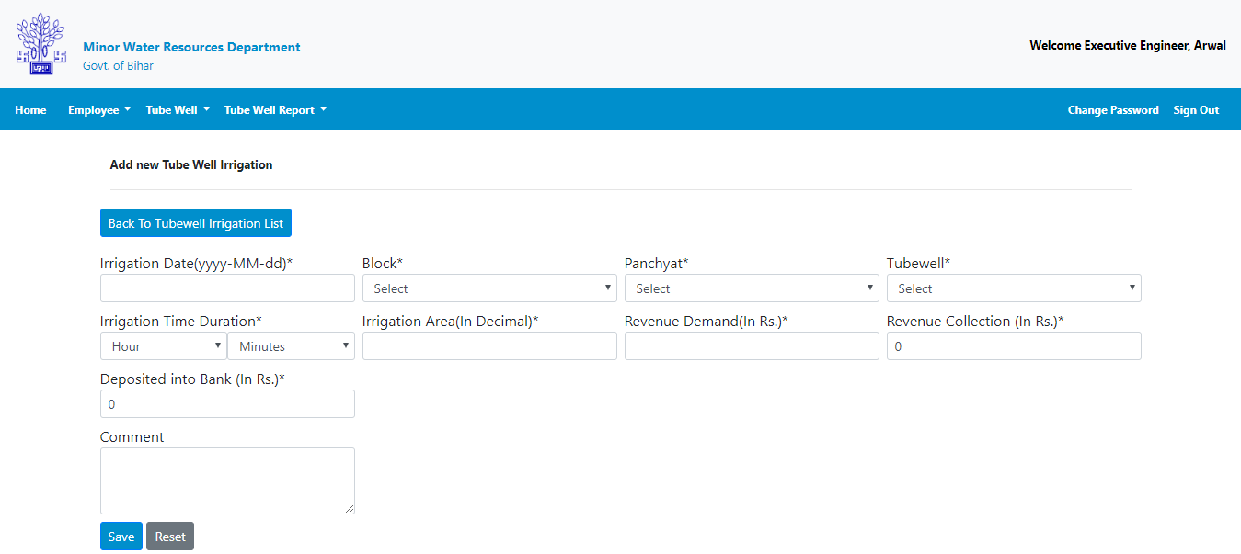
Tube well Software User guide
After adding new irrigation click this button to go back to irrigation page.
Enter required detail and Click on to save button to add new Tube well irrigation.

Slide 16
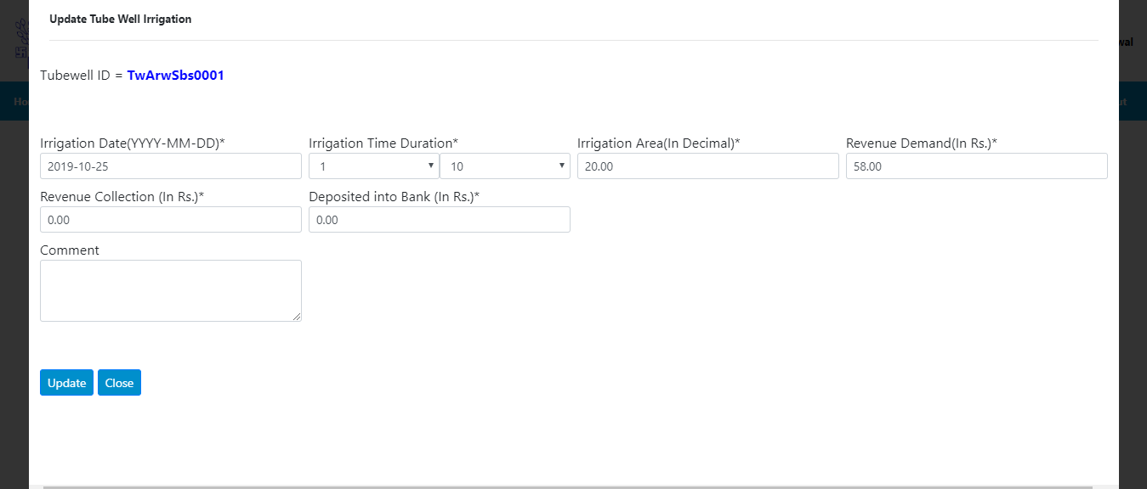
Tube well Software User guide
If required change your data & Click on update button to update.
Click on close button to go back to the irrigation list.

Slide 17
Tube well Software User guide
Click on Tube Well Inspection to navigate to Inspection page.

Slide 18
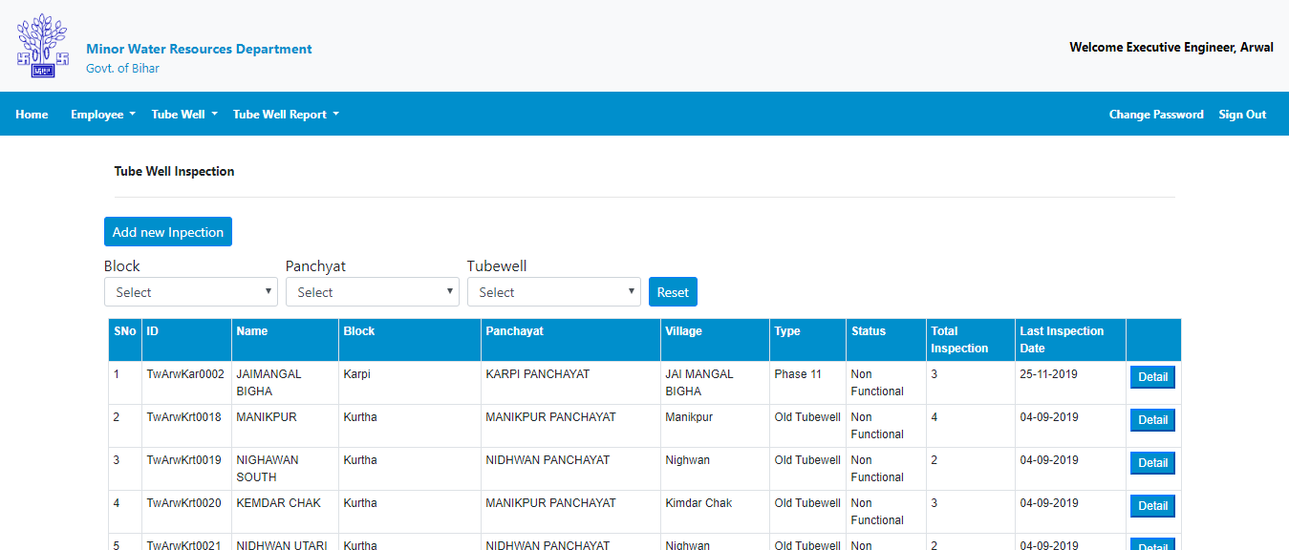
Tube well Software User guide
Click on Add new Inspection add new Inspection.

Slide 19
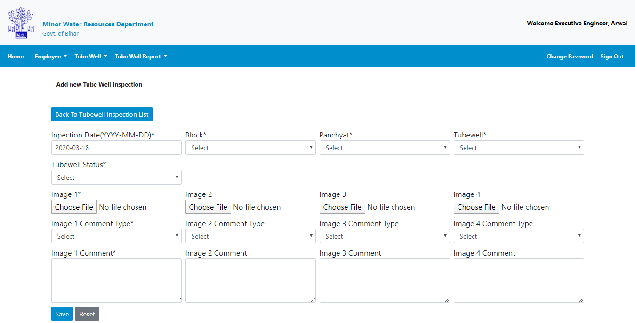
Tube well Software User guide
Note:- Image size must be less than 200 kb and greater than 50 kb.
After adding new inspection click this button to go back to Inspection page.
Enter required detail and Click on to save button to add new Tube well Inspection.

Slide 20
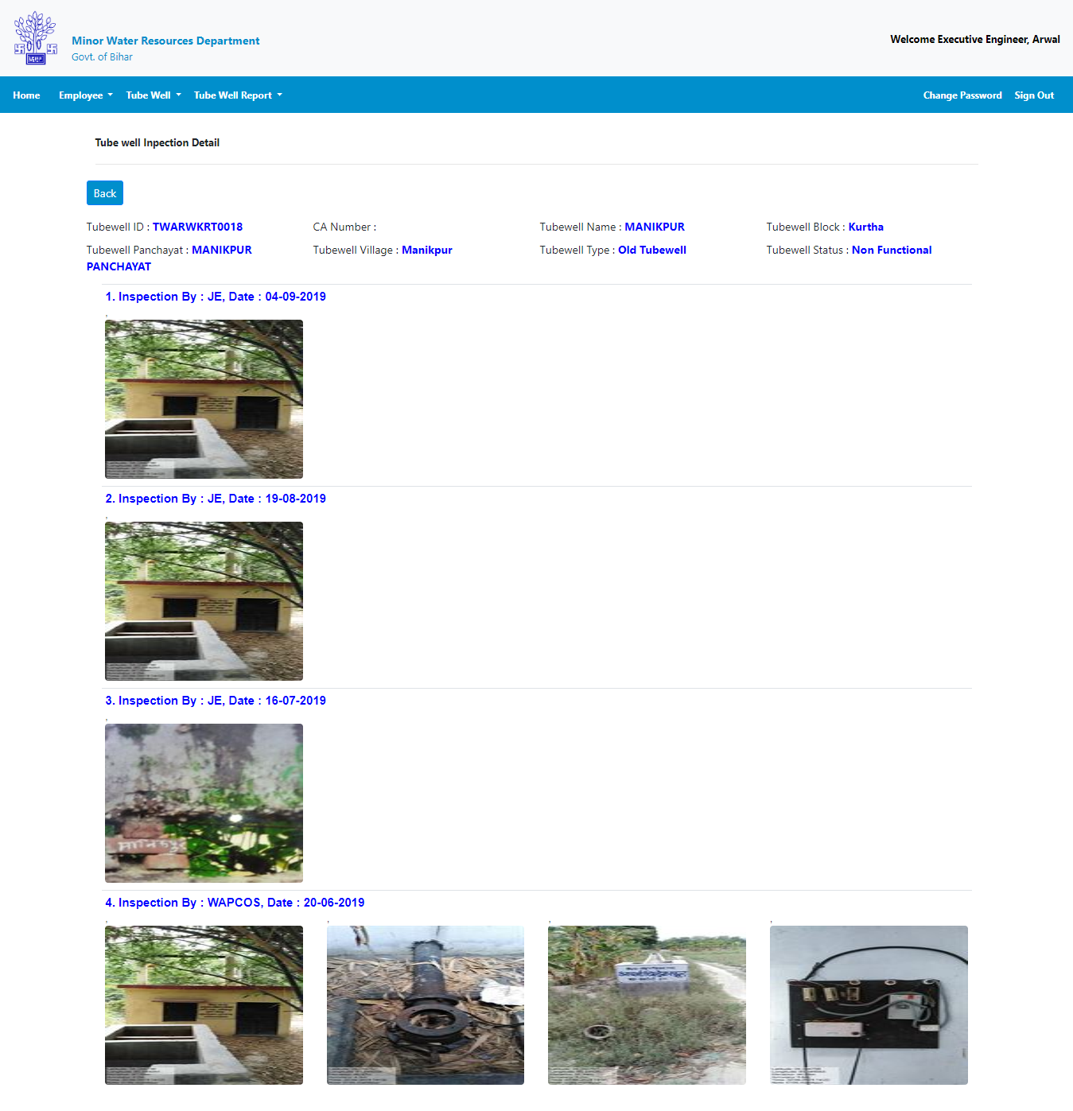
Tube well Software User guide
Here you will see all of your Inspection for a selected tube well.

Slide 21
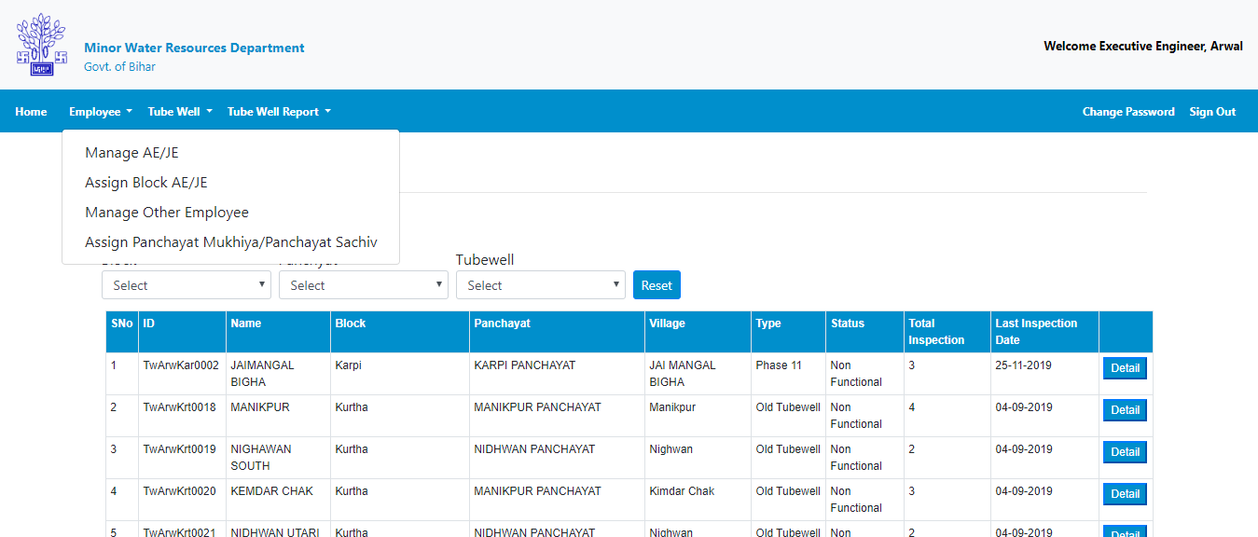
Tube well Software User guide
Click on Employee to expand menu list.
Click on manage AE/JE to AE/JE page.

Slide 22
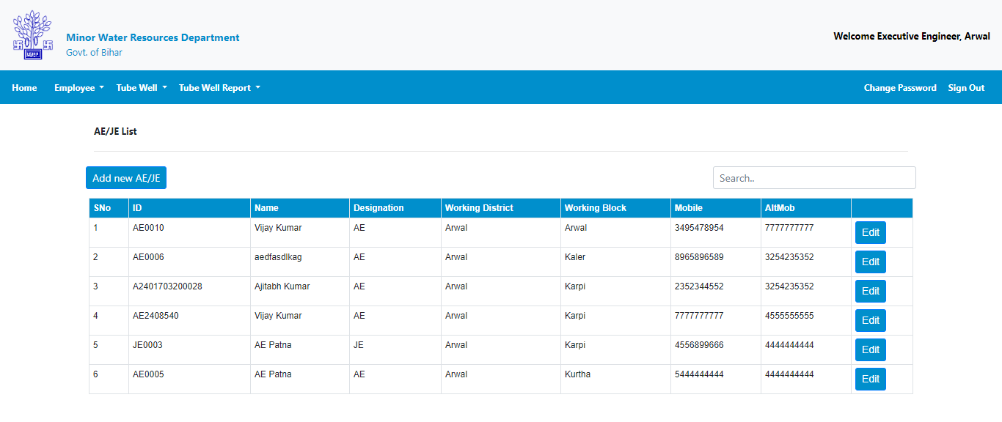
Tube well Software User guide
Click on Employee to expand menu list.
Click on Add new AE/JE.

Slide 23
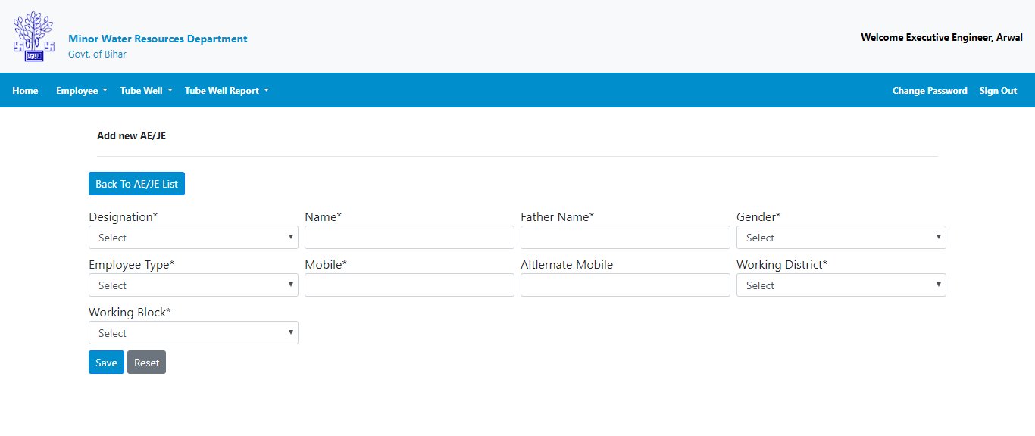
Tube well Software User guide
Note:- ID of Employee will be username and default password will be his mobile number for login.
Click on Employee to expand menu list.
After adding new AE/JE click this button to go back to AE/JE list.
Enter required detail and Click on to save button to add new AE or JE.

Slide 24
Tube well Software User guide
Click on Edit button to update detail.

Slide 25
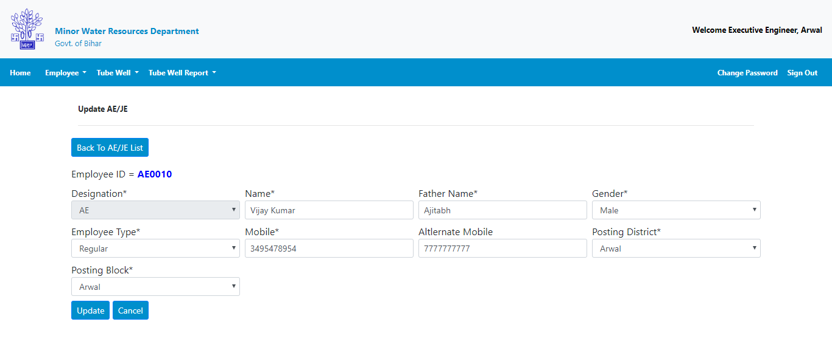
Tube well Software User guide
Click on Edit button to update detail.
If required change your data & Click on update button to update.

Slide 26
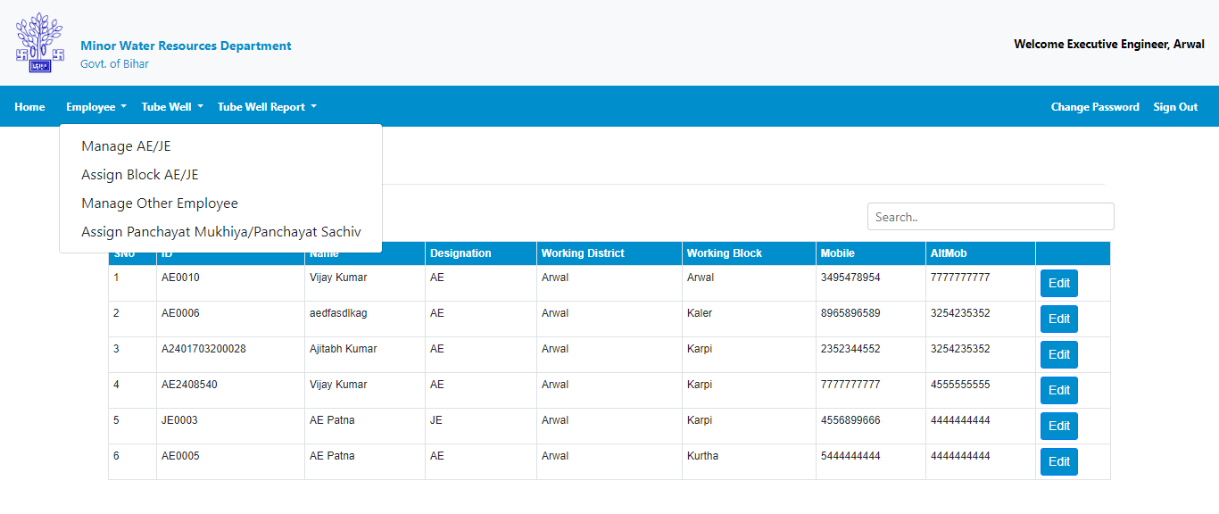
Tube well Software User guide
Click on Assign Block AE/JE to to assign block.

Slide 27
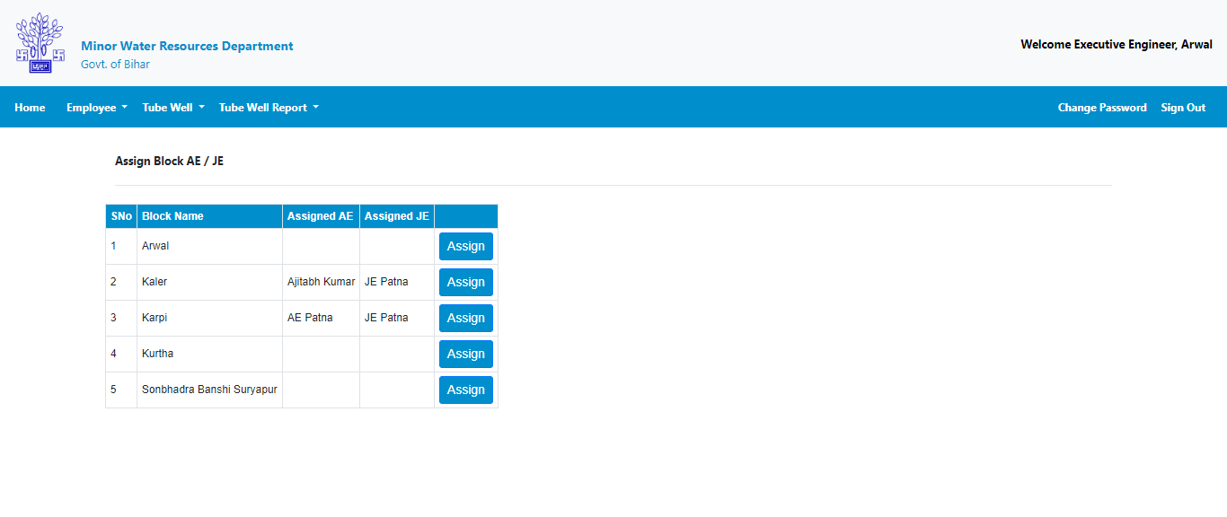
Tube well Software User guide
Click on Assign to assign block to AE/JE.

Slide 28
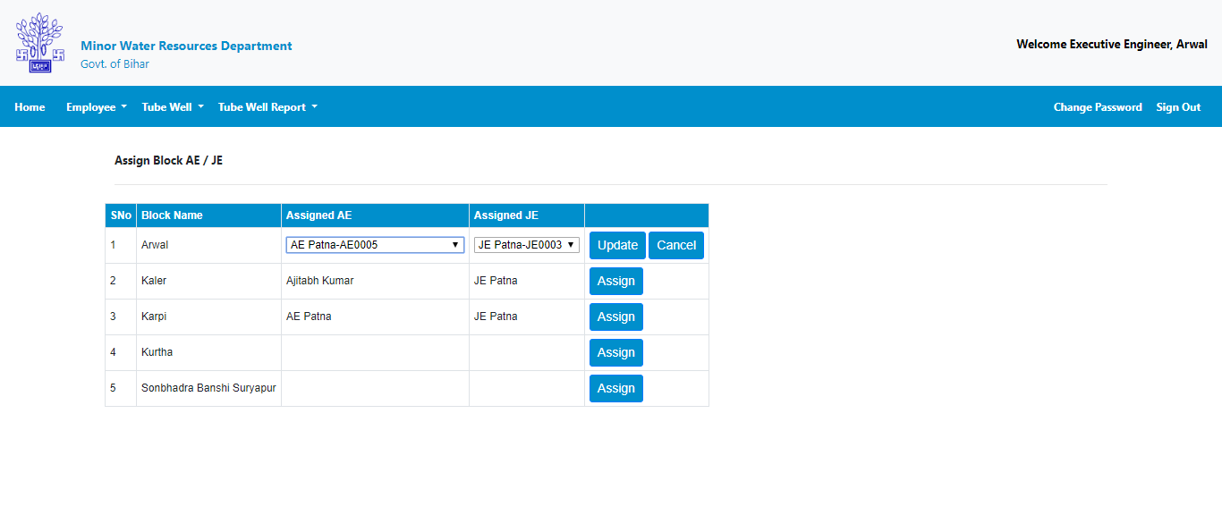
Tube well Software User guide
Select AE and JE from dropdown
Click on update to assign block to AE/JE.

Slide 29
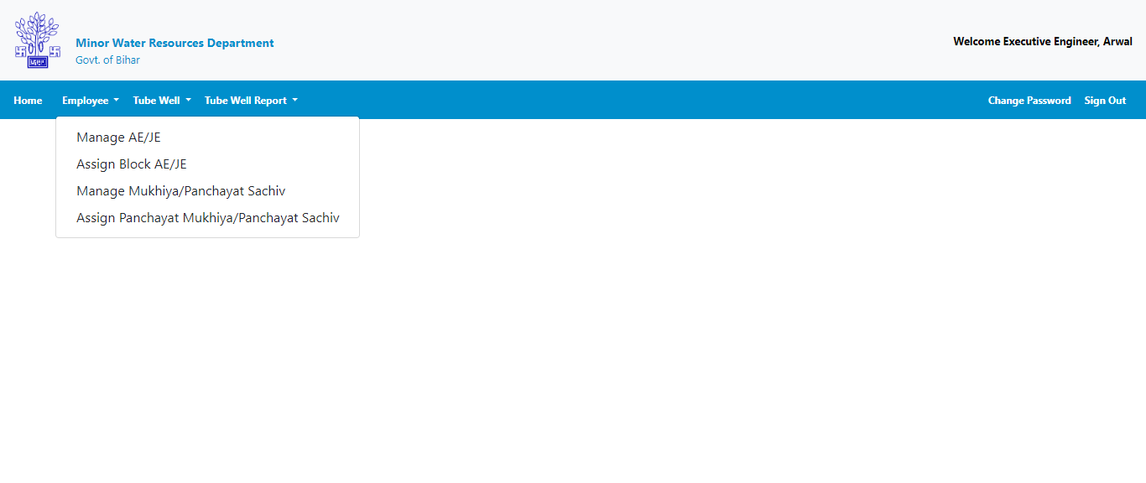
Tube well Software User guide
Select Manage Mukhiya/Panchayat Sachiv.

Slide 30
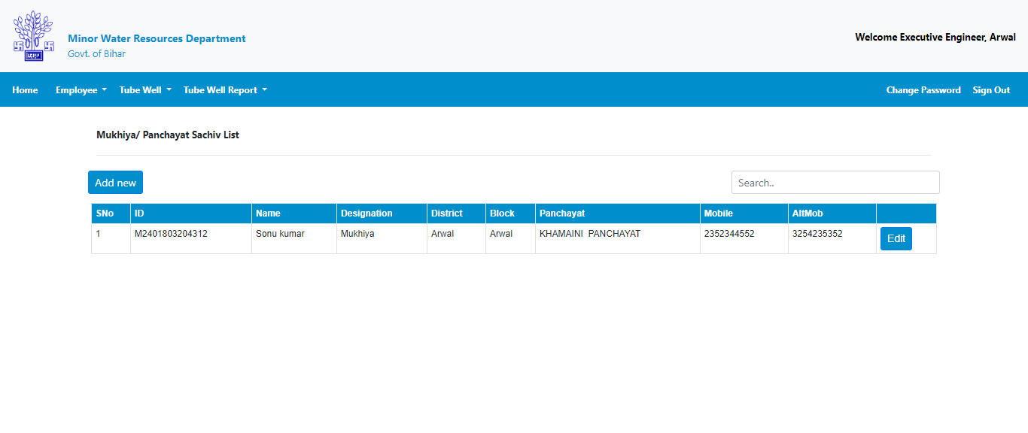
Tube well Software User guide
Select Add new to add Mukhiya/Panchayat Sachiv.

Slide 31
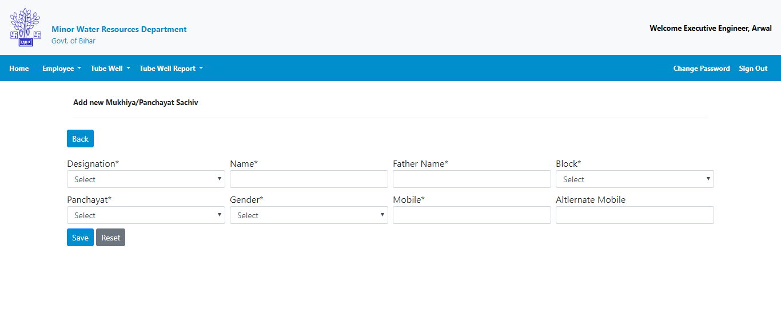
Tube well Software User guide
After adding new Mukhiya/Panchayat Sachiv click this button to go back to Mukhiya/Panchayat Sachiv list.
Select save to add Mukhiya/Panchayat Sachiv.

Slide 32
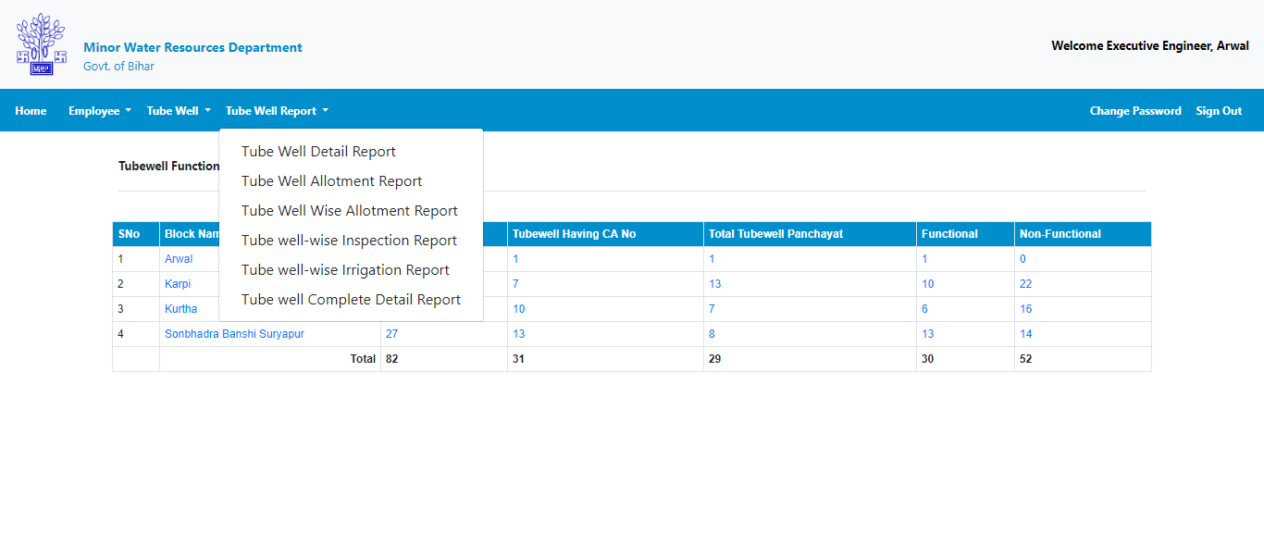
Tube well Software User guide
Various tube well report can be accessed under Tube well report Menu .

Slide 33
Tube well Software User guide
Thanks
For Tube well web Application related issue you can call.
1. Ajitabh Kumar - 9334964593
2. Pragati Rani - 7673001122

